Slide 1
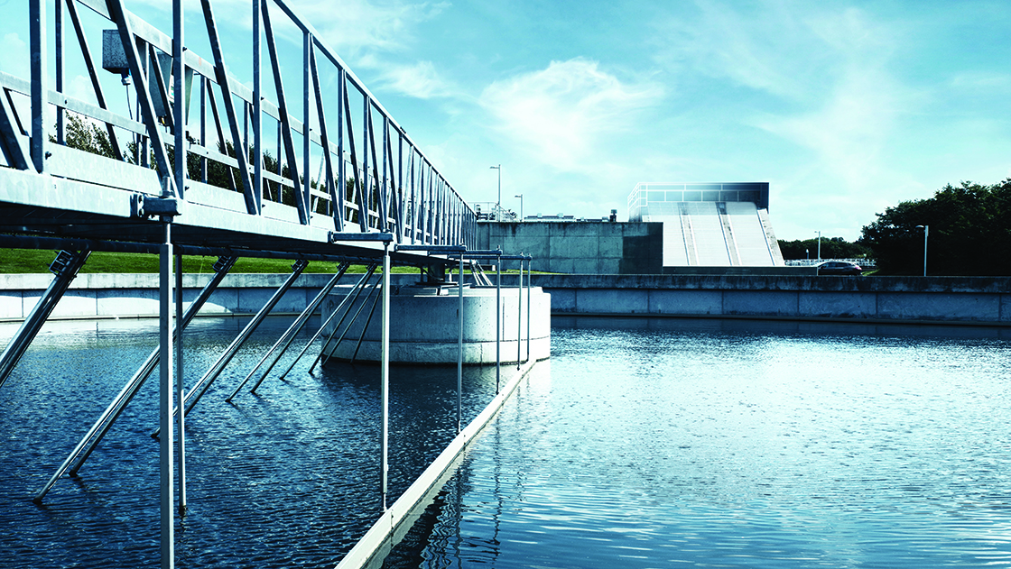
Biogas Wastewater treatment
Process analysis

Slide 2
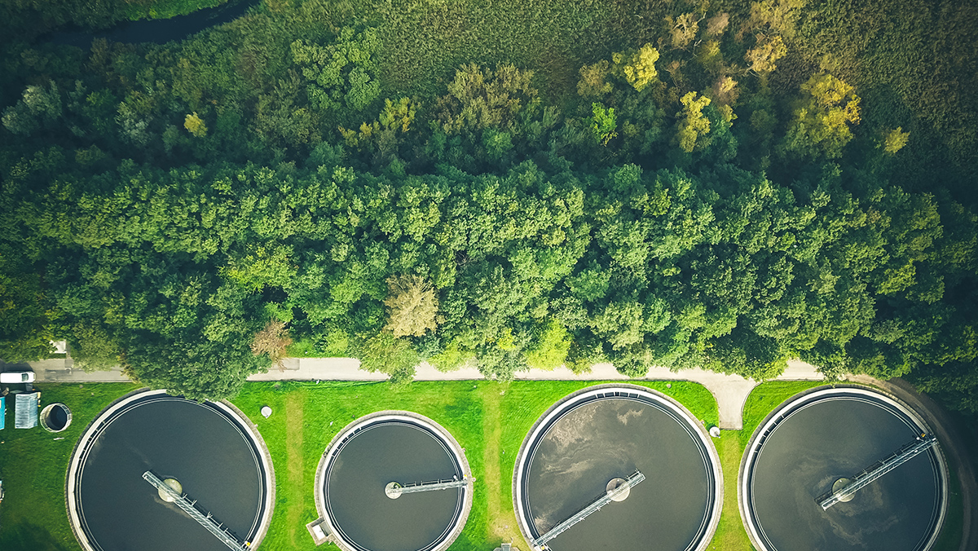
ABOUT INNOVEN srl
InnovEn srl was born in 2013 as an innovative start-up and university spin-off, from professors and researchers of Verona University Biotechnology Department and the Marche Polytechnic University, working as consultancy and research for the development and validation of environmental biotechnologies.
Starting from 2019 InnovEn srl becomes part of TONELLO ENERGIE, one of the main players in the biogas field, focusing on the design, engineering and construction of wastewater treatment plants both in the municipal and industrial fields.

Slide 3
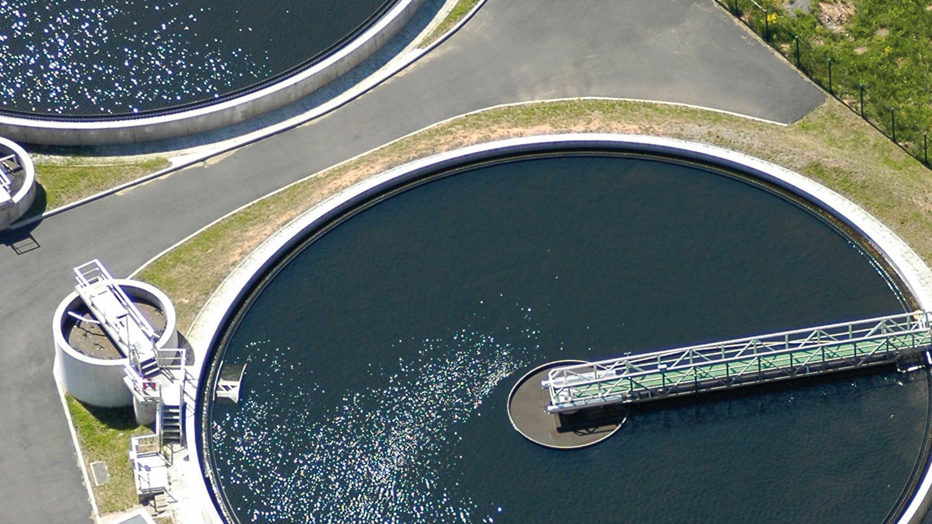
WHAT WE CAN DO
Consultancy: process analysis is the main focus for InnovEn srl. Company can provide consultancy about the state of art of the technologies applied in the wastewater treatment and anaerobic digestion plants, supporting the customer on new technologies;
Engineering: InnovEn srl can provide support to the customer in terms of design of the plant as well as providing all documents required from the feasibility study to the executive project, developing specific solutions to meet customer needs;
Construction: as part of TONELLO ENERGIE, InnovEn srl stands as an EPC contractor taking charge of all the activities from the project to the construction as well as start-up, commissioning and training;
Working both in the wastewater treatment and anaerobic digestion fields, InnovEn srl can develop the whole “package” anaerobic digestion + wastewater treatment, getting the perfect integration of the engineering regarding these two compartments.

Slide 4
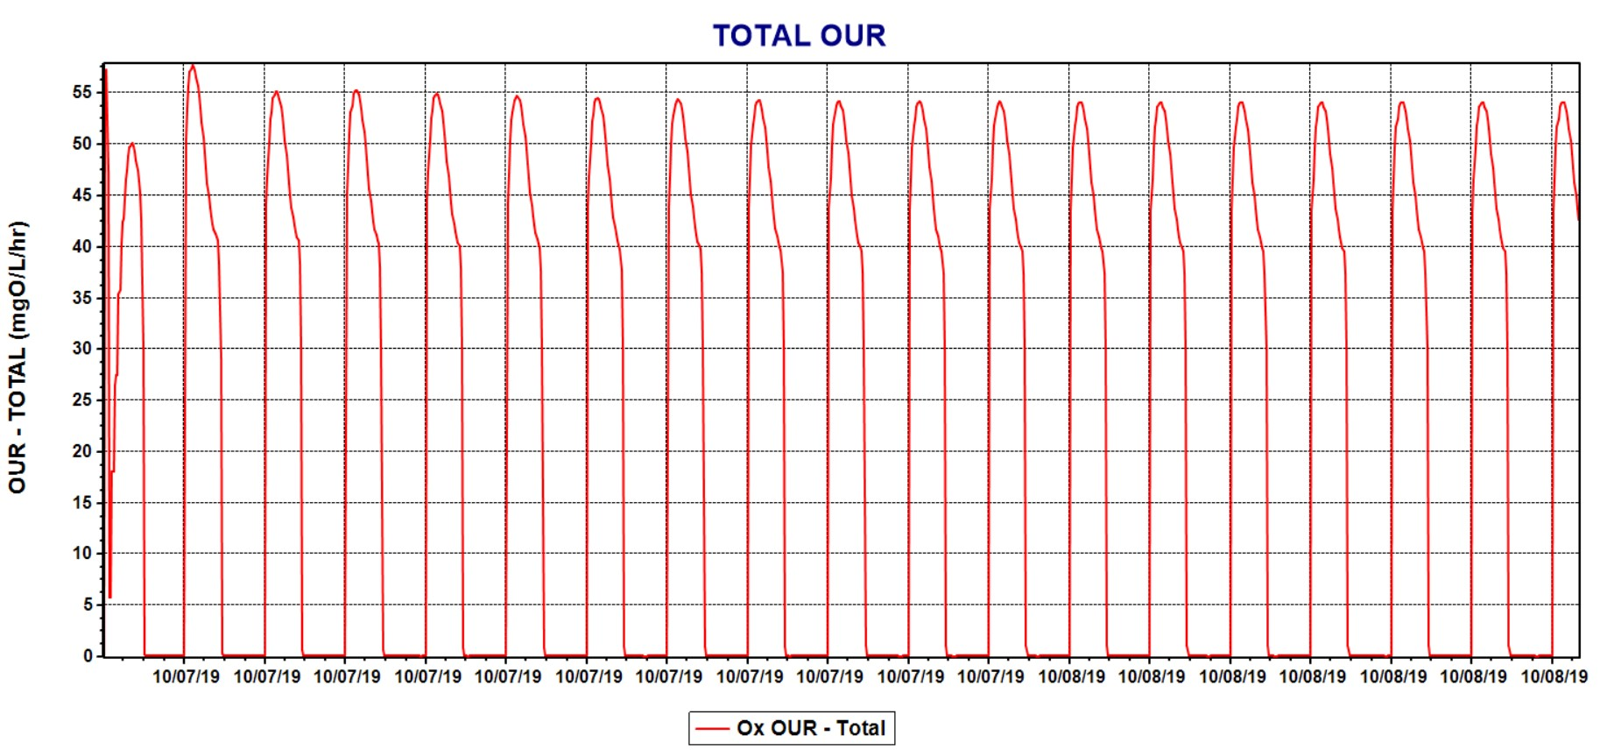
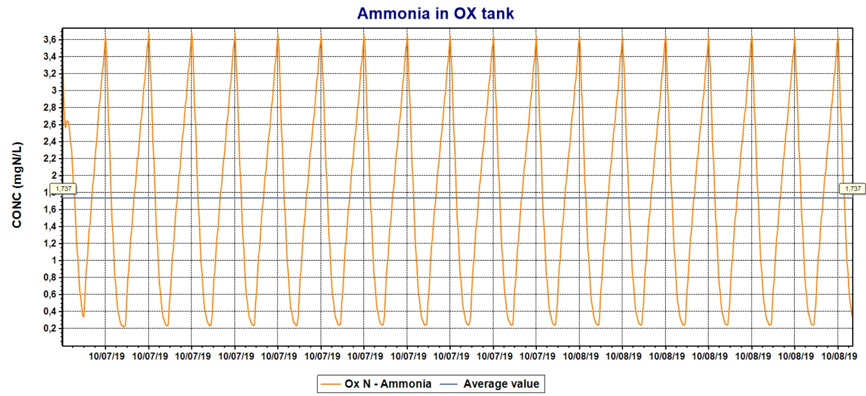
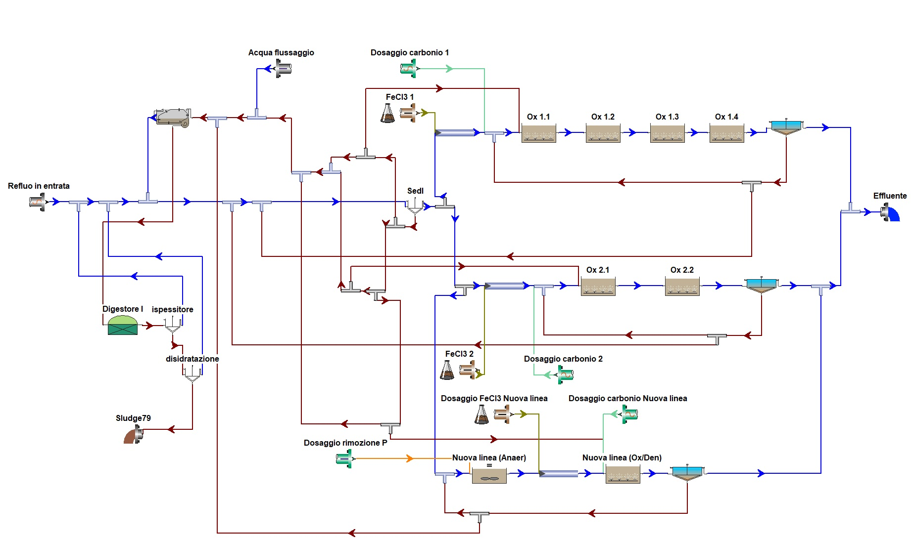
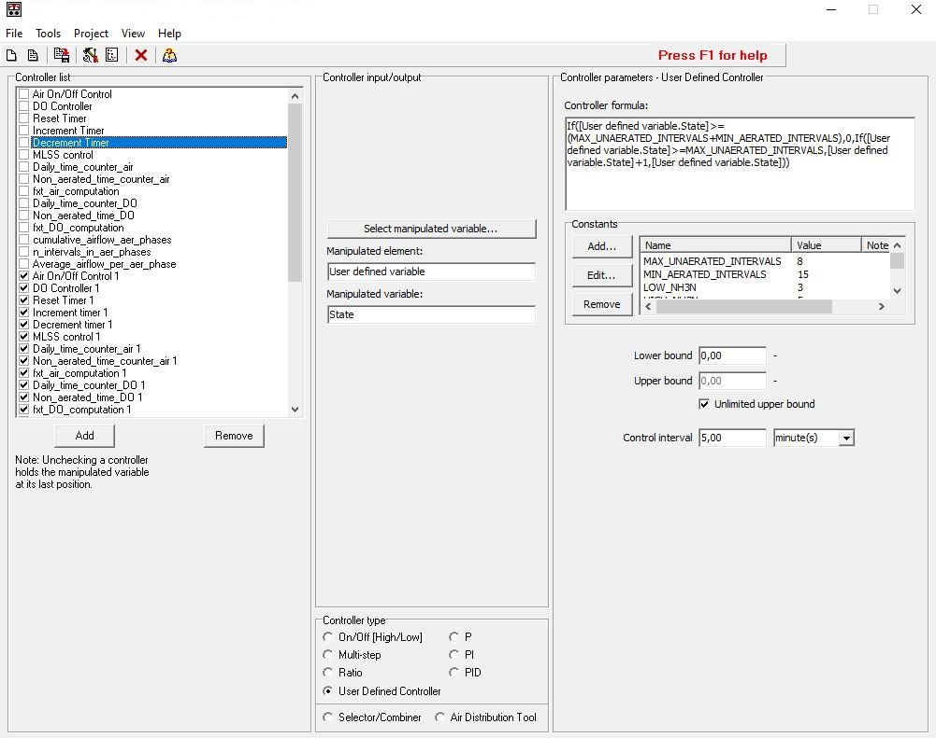
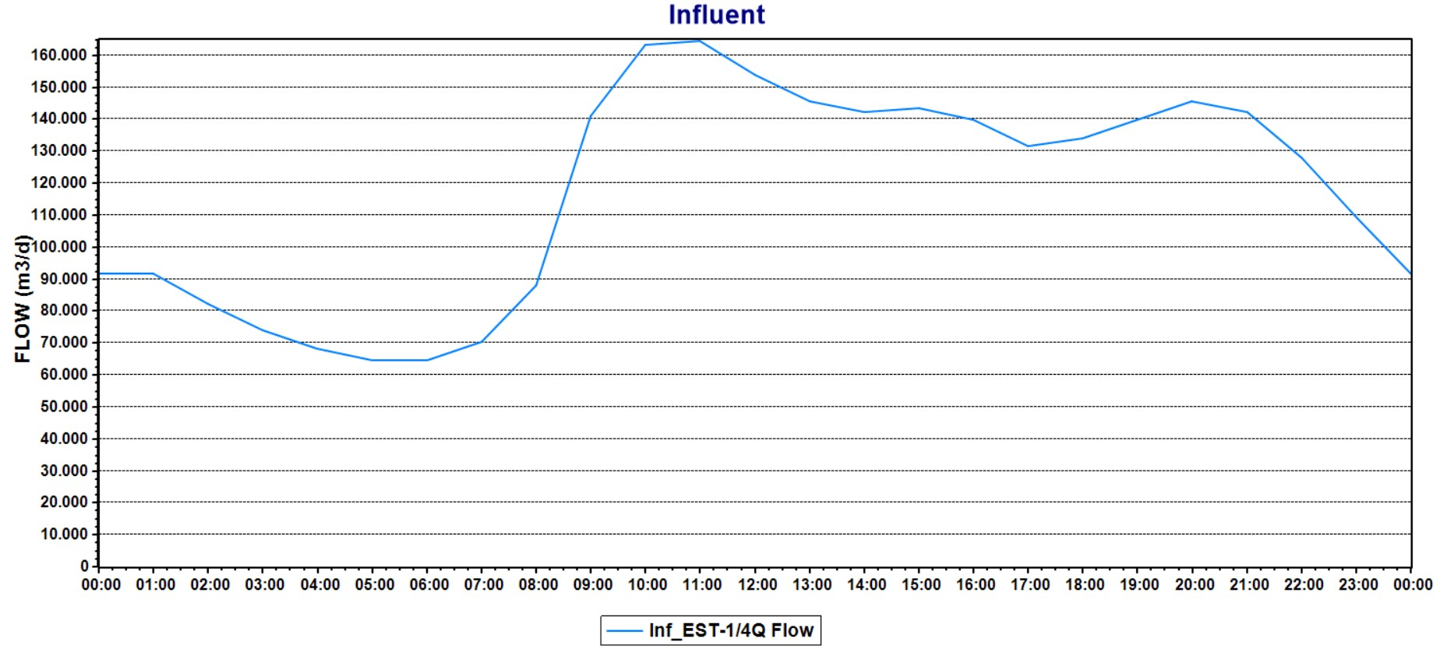
PLANTS SIMULATION
InnovEn srl supports all the activities through of most recent calculation methods and provides plants modelling (through simulation software) for existing plants and new project scenarios.

